Slide 1
Lookout, Limitations and an Effective VFR Scan
Marc Brogan- Chief Advisor Standards, CAA

Slide 2
Effective VFR scan
What is it ?
Why is there such value in teaching the VFR scan?
What part do you play as an instructor?
Informs us for Threat and Error management

Slide 3
Why are we discussing this?
CAA & Aspeq Flight Examiner feedback of poor lookout and scan
Increased number of near-miss events
CAA L&S Review into mid-air accidents in NZ and globally
How well does Human Factors theory translate into practice?
We need to impart a greater practical understanding of the human in the cockpit especially in the Ab-Initio/ formative lessons

Slide 4
SOHJ presentation: 2 years: 153 Occurrences 98 required avoiding action
Number of occurrences; just the reported ones
Continuous work on Situational Awareness and lookout for a number of years
“Too close for missiles, switching to guns….”
Integrate and understand basics to use with technology

Slide 5
So, what do I mean; “switching to guns”?
Missiles are the tech, guns are the eyeball
Try to blend Human Factors with each flight- TEM; Simple principles
So, today we will explore the lookout from our office…..
Refresh some basic concepts and re-introduce some Human Factors
Next slide is confronting with accident images

Slide 6
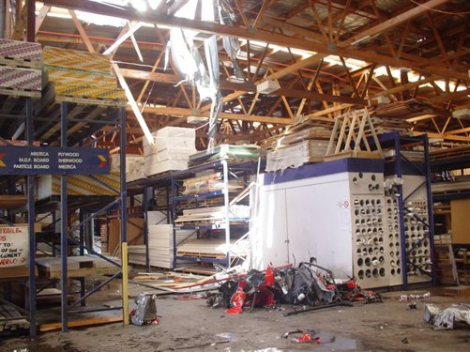
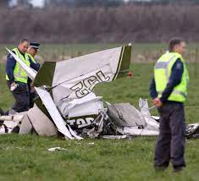
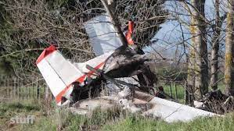
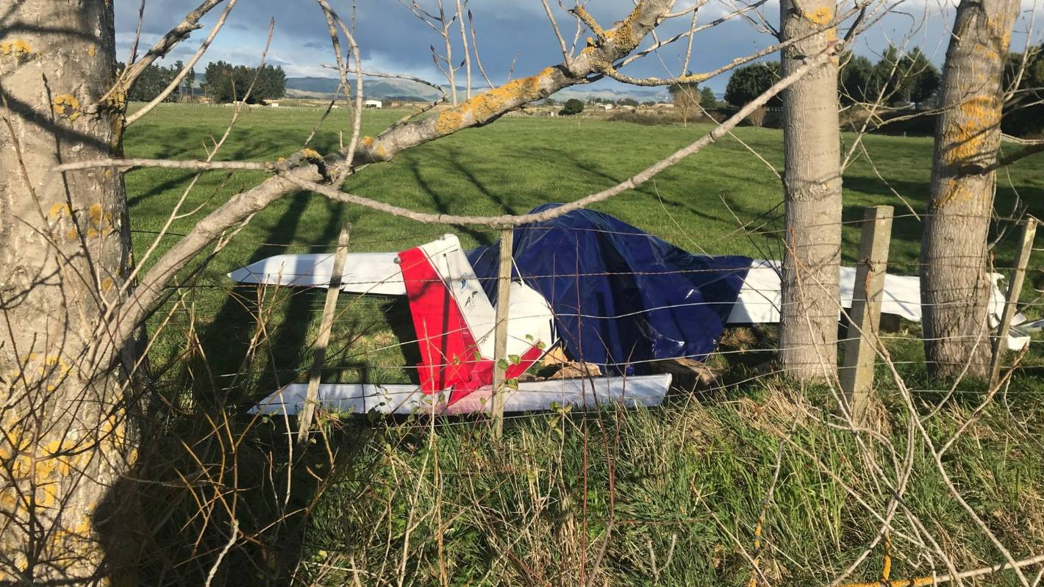

Slide 7
Mid-Air accidents in NZ
Geographic closeness; peculiar but also a bottle-neck of activity (lower Nth Island)
Three unattended aerodromes; all aircraft at home airfield
Large number of R/T calls- congestion
Clear VFR met condx
Non-standard practices
Psychological stressors; diffusion of roles & gradient/ commercial demand
Phases of flight; pitch, bank or both
Therefore; Physiological stressors
Environmental; thermal variations or extremes
Many of the above outlined in ATSB report: Limitations of See and Avoid

Slide 8
See and Avoid principles
Self-separate
Identify and position as required
Avoidance of conflict - both 1 & 2 are reliant on you; single “slice of cheese”

Slide 9
Greater understanding required on the lookout and scan then- how to make more effective
This awareness needs to start early and to be taught with situations and scenarios for consideration

Slide 10
We commonly use a drawing of this image for instructing

Slide 11
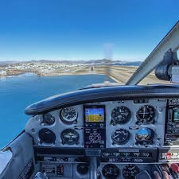
So, what and how do we see?
Because it is not this….

Slide 12
But, we don’t see in “landscape”
We see with varying degrees of acuity relying on stimulation such as movement through a steadily reduced “frame”- our peripheral vision (approx. 190 deg)
We tend to scan across this periphery
This is our field-of-view; FOV- we therefore need to “shift” our peripheral vision.
Why?? Let`s experiment……

Slide 13
Hold you two index fingers out in front of you- keep them still. You can focus very clearly as they remain still; Foveal vision
Move them slowly around your head at arms length- test your vision; up/down and to your periphery. Keep them still.
Now at full peripheral range move your fingers; your peripheral vision identifies movement better than your foveal vision.
(Be aware though that an object with the same relative position will not stimulate that peripheral vision and is harder to see)
Therefore; use both types of vision during your entire scan.

Slide 14
The VFR scan uses the horizon- remember you identify the aircraft attitude relative to that horizon.
In the next slide- the actual FOV, note how limited the horizon is versus the previous “ideal” images.
Horizon is reduced with Pitch/ Bank or both.
The following images give a new and practical insight into how the scan can work to a horizon

Slide 15
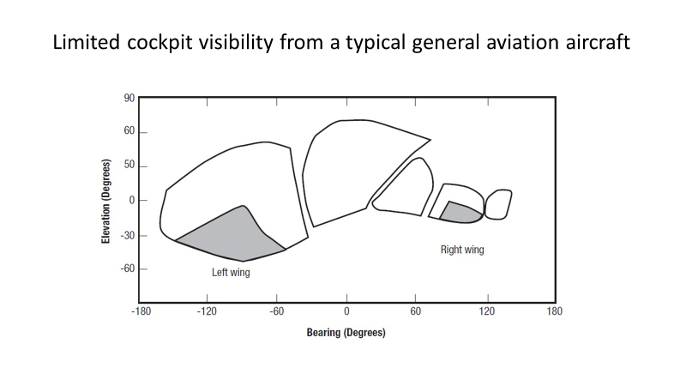
ATSB diagram-FOV
Obstructions wider than the distance between our eyes may be mask objects completely
If one eye focuses on the obstruction, ability to identify a target diminishes

Slide 16
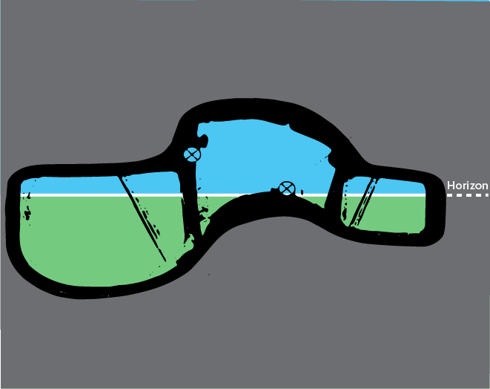
LHS

Slide 17
Now we turn the aircraft left. If we remain upright in the seat then the horizon is angled relative to our peripheral vision.

Slide 18
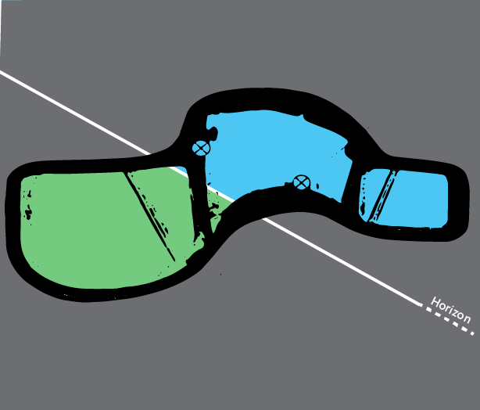
LHS

Slide 19
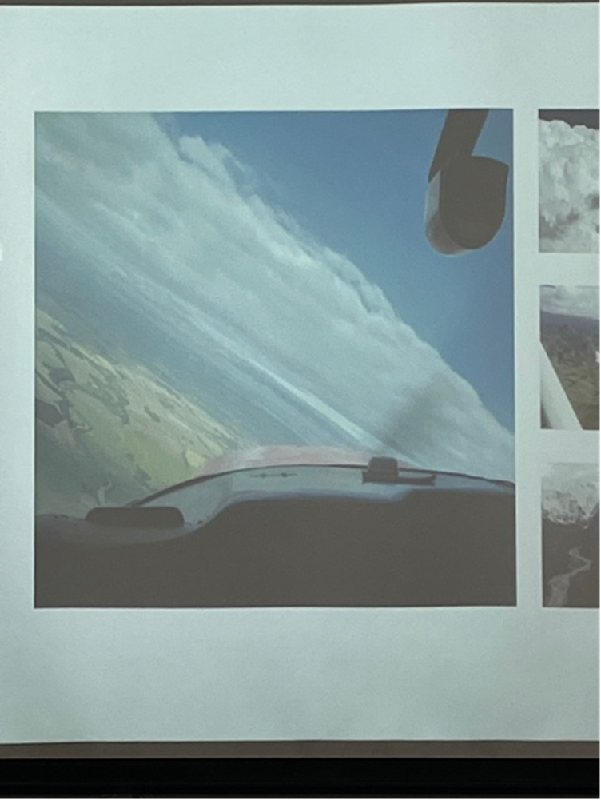
LHS

Slide 20
The previous image reflects that used in a turning briefing however, this image is often used to show Angle of bank, not how to employ the VFR scan.
However, if we lean away from the turn slightly, we align our peripheral vision to the horizon and open up the scan in the direction of the turn relative to the horizon- the very reference all other aircraft are flying to.

Slide 21
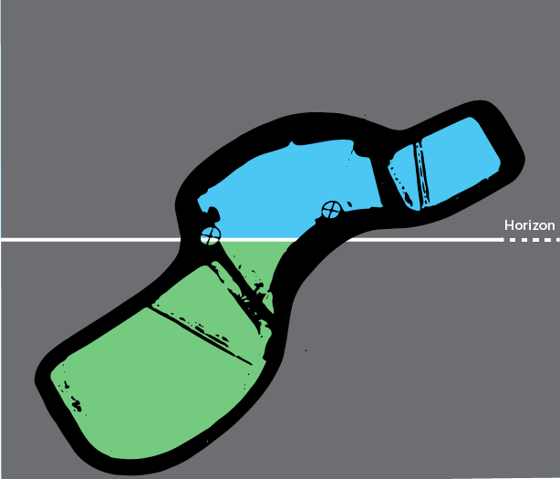
LHS

Slide 22
…the same applies for the right-hand turn…
And when in the other (Right-Hand) seat

Slide 23
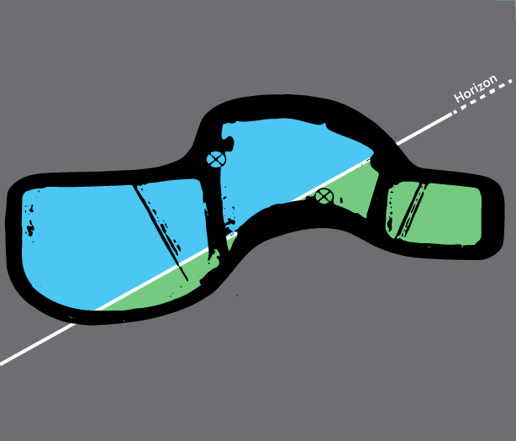
LHS

Slide 24
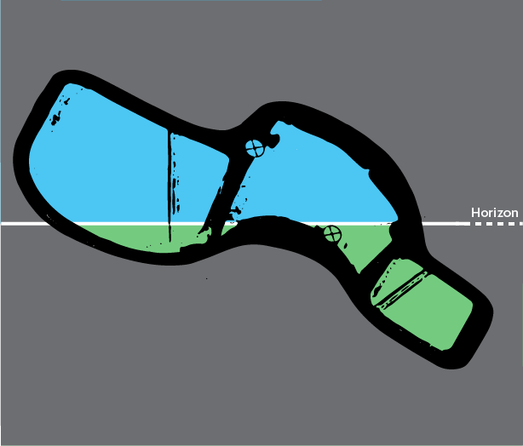
LHS

Slide 25
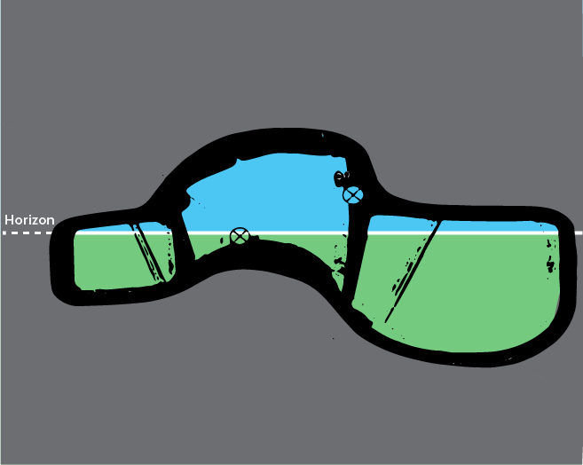
RHS

Slide 26
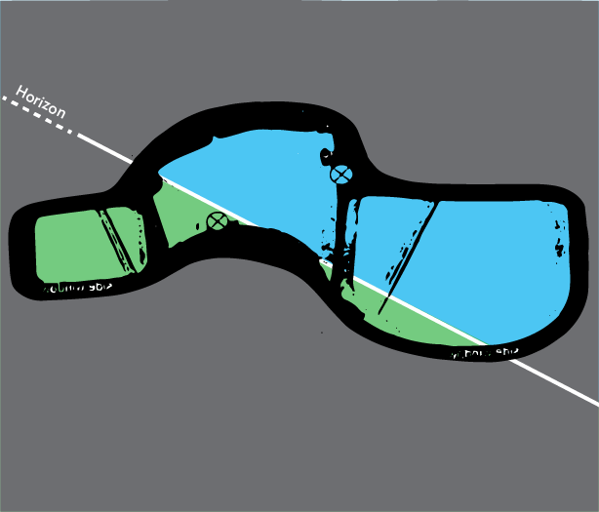
RHS

Slide 27
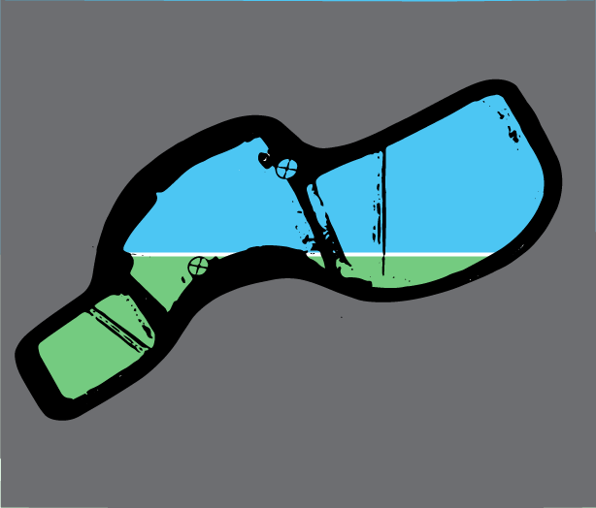
RHS

Slide 28
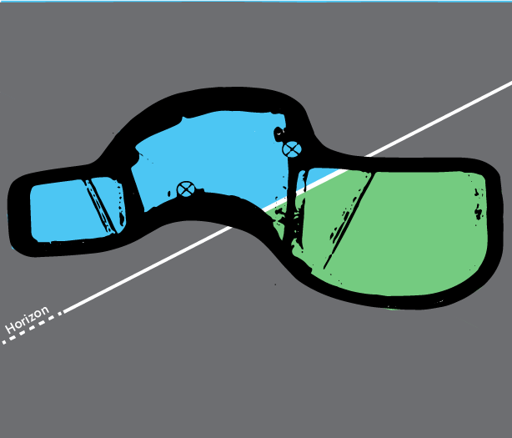
RHS

Slide 29
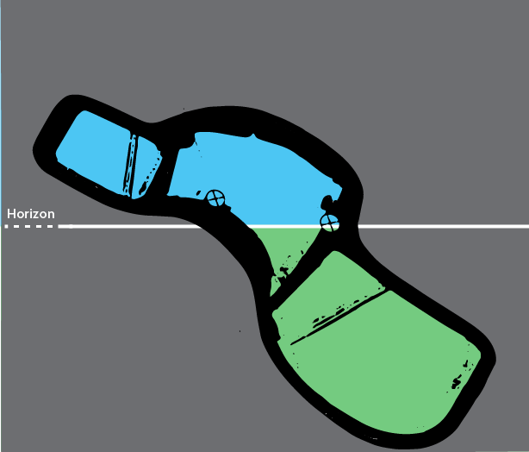
RHS

Slide 30
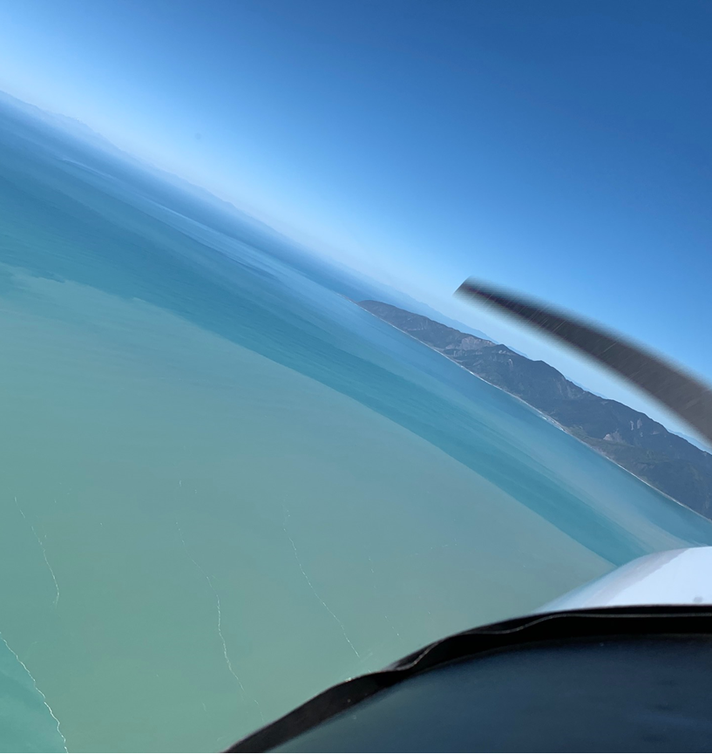

Slide 31
This view shows a left-hand turn with the camera upright

Slide 32
LHS

Slide 33
Then the camera is tilted to the right to be perpendicular to the horizon; simulating the “lean away” from the turn.

Slide 34
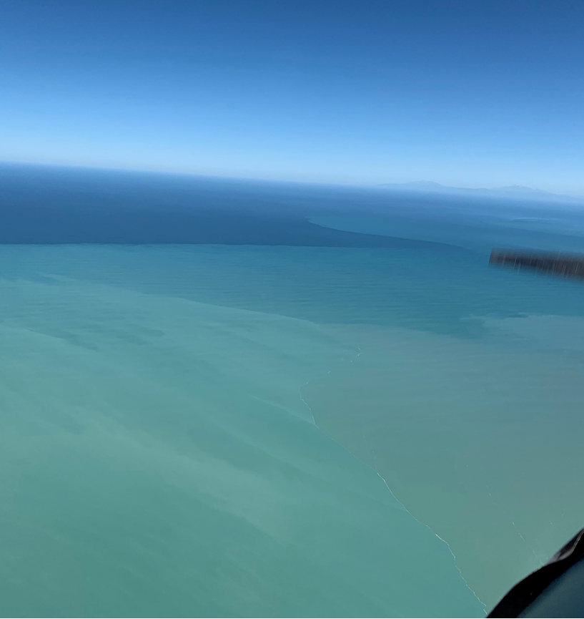

Slide 35
LHS

Slide 36
What other limitations are there?
Dirty and/or damaged window
Sun; use sun glasses w/ approved lenses (clean!)
Scan-rate; 20 Degrees/ 2 secs
Lack of relative motion

Slide 37
Lack of relative motion- into your periphery which responds to movement

Slide 38
What other limitations are there?
Dirty and/or damaged window
Sun; use sun glasses w/ approved lenses (clean!)
Scan-rate; 20 Degrees/ 2 secs
Lack of relative motion
Human cognitive ability

Slide 39
Identification and response time

Slide 40
So, if this is considered in the Mid-Airs or areas of high-risk…
We need to stack the odds or “slices of cheese” in our favour.

Slide 41
Consider the impact of not having a good lookout for you and your students…
Resources available:
ATSB https://www.atsb.gov.au/publications/1991/limit_see_avoid.aspx
FAA AC 90-48D AC 90-48D - Pilots' Role in Collision Avoidance (With Change 1) – Document Information (faa.gov)
EASA https://www.easa.europa.eu/sites/default/files/dfu/Final%20Report%20EASA.2011.07.pdf

